Slide 1

Module 3.3
PLCs Configuration

Slide 2
Plcs Configuration
Notes:
This page intentionally blank

Slide 3
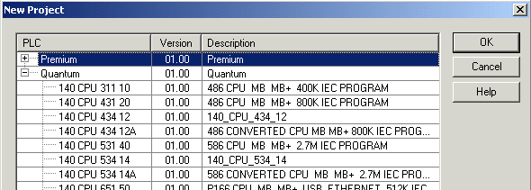
Processor choice
First step to create an application
  Choose the platform : Premium or Quantum (not interchangeable)
  Choose the processor type

Slide 4
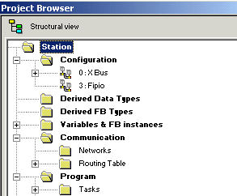
Access to the configuration editor
Accessible from the Structural View to
  Configure the racks of the local bus
    address 0 for the Premium PLCs
    address 1 for the Quantum PLCs
  Configure the remote racks (X Bus or remote I/O)
  Configure the field bus
  Link communication hardware to logical network (Ethernet, Modbus +, Fipway)

Slide 5
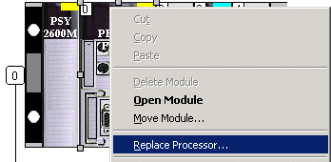
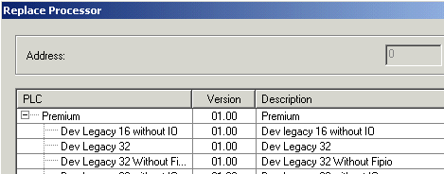
Processor replacement
To modify the type of processor
  Right click on the processor
  Only the same family of processors is proposed (ie Premium)
  Processor replacement is possible only in off-line mode
Note : Quantum processor can be placed anywhere in the rack

Slide 6
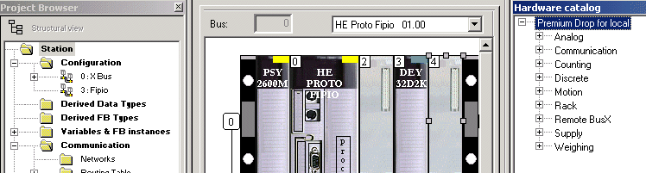
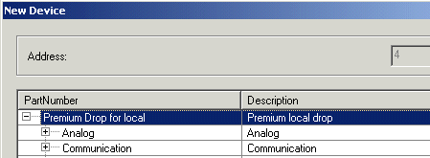
Premium rack configuration
(1)
(2)
Choose the rack
Define the power supply module (left position)
Replace the processor (if necessary)
Define the modules : double click on the blank position and add a device (1) or drag & drop from the hardware catalog (2)

Slide 7
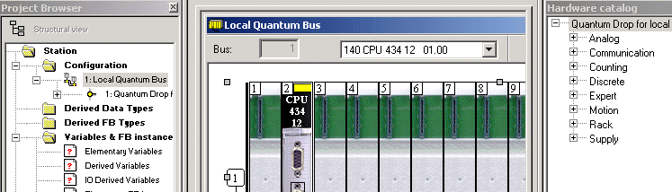
Quantum rack configuration
Choose the rack
Define the power supply module (first or last position suggested)
Replace or move the processor (if necessary)
Define the modules

Slide 8
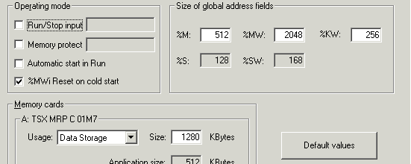
Premium processor configuration
Select the operating mode : Run/Stop input, memory protect, ...
Define the memory cards
Define the global objects of the application : number of bits and words

Slide 9
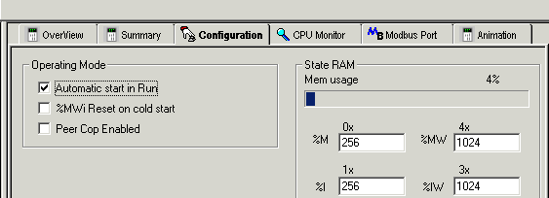
Quantum processor configuration
Select the operating mode : automatic start in Run, Peer Cop, ...
Define the global objects of the application : number of bits and words

Slide 10
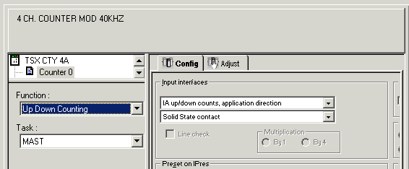
Module configuration
Overview of the module
Configuration of the parameters of each channel (in local mode)
Adjust of channels in local mode (expert module)

Slide 11
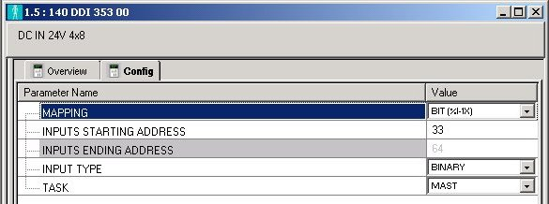
Quantum module addressing
Define the addresses used by Quantum module : mapping (bit, word) and first address (ie : 33)
Define the others parameters : type, task, ...

Slide 12
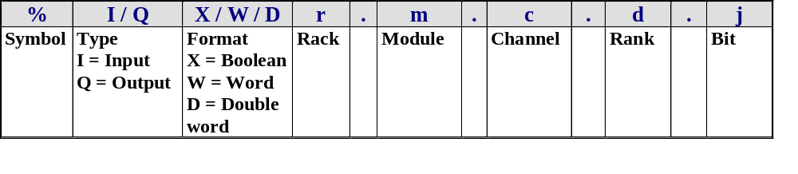
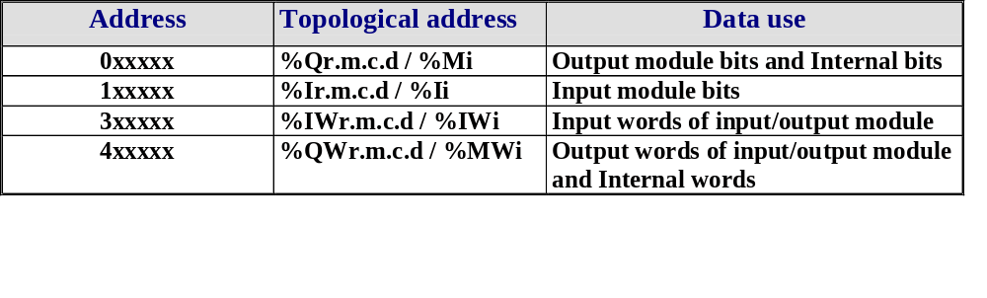
Topological addressing
Physical addressing of input / output
Topological address of Quantum located data
Notes:
In the IEC standard, the object is defined by :
a Symbol : %
a type : M : for internal variables
K : for constants
S : for system variables
N : for network variables
I : for input variables
Q : for output variables
a format : X : boolean (Implicit in Unity, don't need to write it)
B : byte (not used in Unity)
W : word
D : double word
F : real

Slide 13
Principle to configure a network
To configure a network (Ethernet, Modbus+ or Fipway) :
  Create the logical network
  Configure the logical network
  Define the communication module or the PCMCIA card
  Associate the module or the PCMCIA card to the logical network

Slide 14
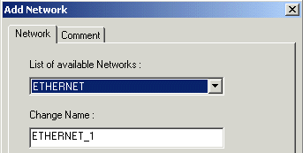
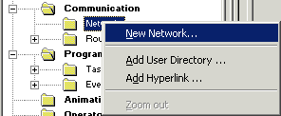
Create a logical network
(1)
(2)
Add a new network (right click on the Networks folder of the application browser) (1)
Choose the type of network to create (Ethernet, Modbus+, Fipway) and define its name (2)
If necessary enter a comment

Slide 15
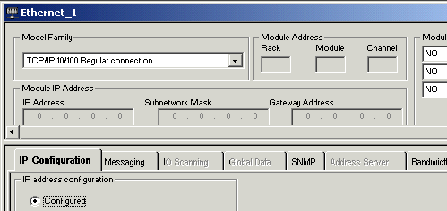

Configure the logical network
(1)
(2)
Activate the logical network to configure (1)
Configure the logical network : global data, I/O scanning, ... (2)

Slide 16
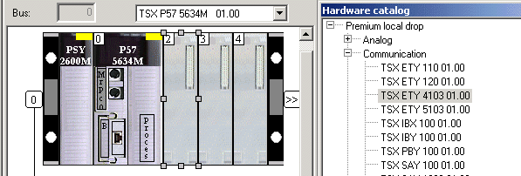
Define the communication module / PCMCIA card
Define the communication module (drag & drop from the hardware catalog)
Or define the PCMCIA card (double click on the card position and add submodule)

Slide 17
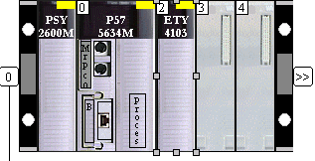
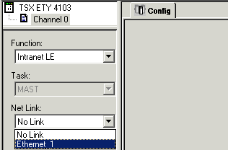
Associate the module / card and the logical network
(2)
(1)
(3)
Open the communication module (1)
Select the channel (2)
Associate the module to the logical network (3)

Slide 18
CANopen Bus

Slide 19
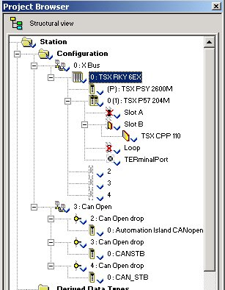
CANopen fieldbus
CANopen bus available for the Premium configuration
Use the TSX CPP 110 PCMCIA card
Note : mandatory for the PCMCIA card to be installed in the slot located in the CPU
From the configuration editor :
  Declare the card in the hardware configuration
  Configure the bus with SyCon software (V 2.8)
  Import the fieldbus configuration in Unity Pro
  Access to I/Os through topological addresses
Notes:
1) : this maximum size can be exceeded if you load the configuration into the card using the Sycon software. The maximum size of configuration data authorized by the Sycon software is 256 Kb.
(2) : these processors are available for Unity Pro versions higher than V1.0

Slide 20
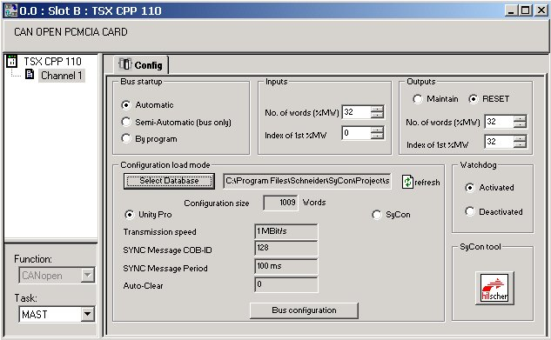
CANopen Methodology
4
3
1
6
7
5
8
2
Notes:
1.Select the TSX CPP 110 in the Channel 1
2.Define the Fast, Mast task to set the rate of update for the storage areas associated with the I/O
3.Configure the Bus start up mode (controlled by the application or not)
4.Define the input/output restart in case of PLC stop (Remain or reset)
Define the range of addresses for the input/output
5.Launch the SyCon tool to configure the bus
Create the *.CO file (example : test_can.co)
6.Select the *.CO file to integrate in the Premium (example : test_can.co)
7.Choose the type to transfer the bus configuration into the PCMCIA card :
PL7 : the bus configuration is loaded with the PL7 application
SyCon : the bus configuration is loaded with the SyCon tool.
8.Press on Bus configuration to see the list of slave connected on the bus
To configure the inputs/outputs of the slaves on the bus, it is necessary to indicate a memory zone to which they will be copied periodically. To define this zone, indicate:
A number of words: this is the number of input words corresponding to the size of input data configured by the Sycon software.
Address of the first word: this is the address of the first word in the input memory zone.
When you click this button, the selected *.CO file is reloaded and evaluated. This action must be performed after each modification SyCon makes to the selected *.COfile.4.

Slide 21
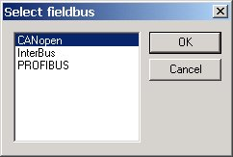
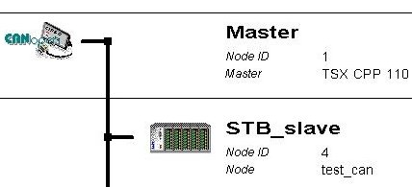
SyCon Configuration
If necessary create a new CANopen field bus
Copy the EDS file of the slave if not in the library
  File => Copy EDS command
Note : the file is copied in the folder •••\Schneider\SyCon\Fieldbus\CANopen\EDS\*.eds
From the configuration editor :
  Insert the CANopen master TSX CPP 110
  Insert the slave by choosing the type in the list
  Select the node ID
  Define the bus settings
  Example : with Advantys STB
Example : with Advantys STB

Slide 22
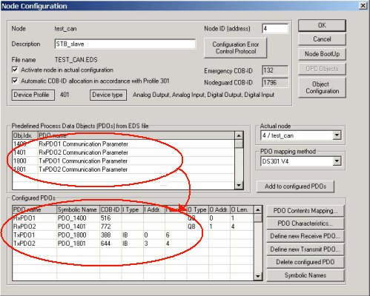
PDOs Configuration
Predefined PDOs are given directly by the EDS file
Double click on the slave
Validate the PDOs
  Double click on
  Choose the transmission mode (recommended to use the default settings)
  Press on the Ok button
Note : for each Tx and Rx PDOs

Slide 23
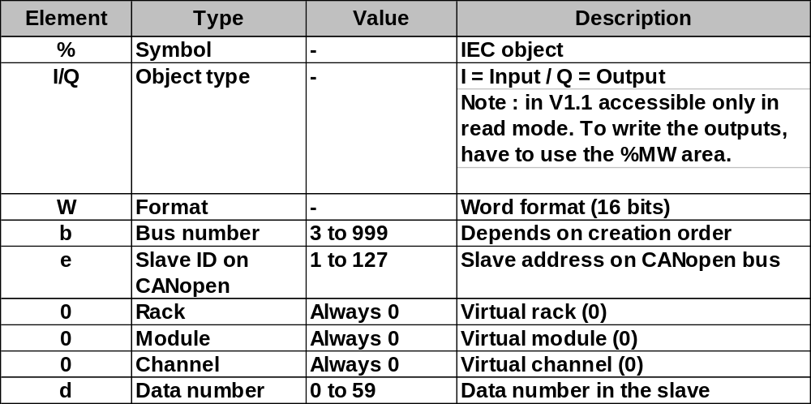
Topological addressing
Physical addressing of input / output

Slide 24
Fipio Bus

Slide 25
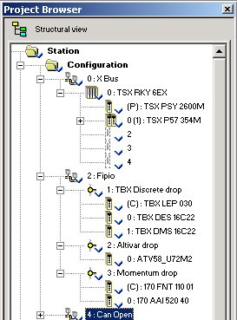
Fipio fieldbus
Integrated configuration of Fipio
  Embedded configuration screen (like PL7)
Use the Fipio CPU (TSX P57 •5•)
From the configuration editor :
  Access directly to the integrated bus configurator
  Declare the slaves on the bus choosing in the hardware catalog
  Access to I/Os through topological addresses
Note : Support of all the I/O modules already supported under PL7

Slide 26
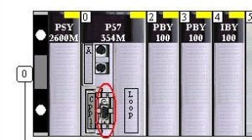
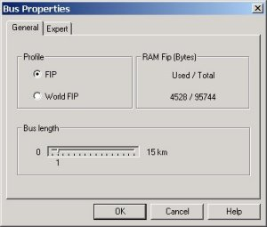
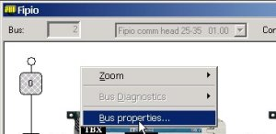
Fipio Methodology
1 - Double click on Fipio port
2 - Right-click in the Fipio configurator
3 - Define the profiles used and the length
1
3
2

Slide 27
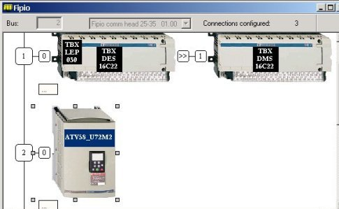
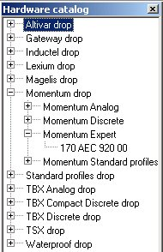
Fipio Methodology (cont'd)
1 - Drag and drop from the hardware catalog into the Fipio configuration
2 - Enter the address of the new slave

Slide 28
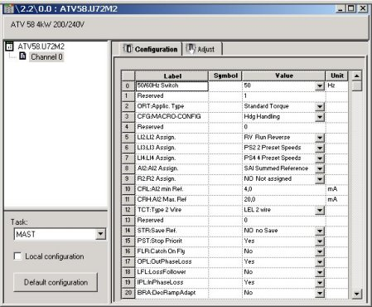
Fipio Slaves
To access to this screen, double-click on the slaveThis screen allows to :
  Configure the communication channel
  Set the parameters of the slave

Slide 29
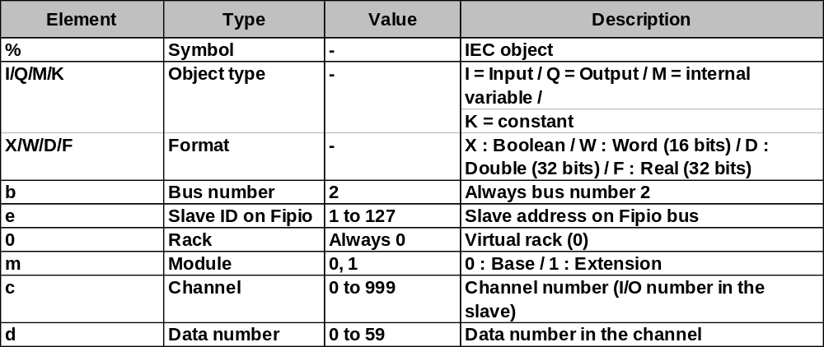
Topological Addressing
Physical addressing of input / output

Slide 30
Remote I/O Distributed I/O

Slide 31
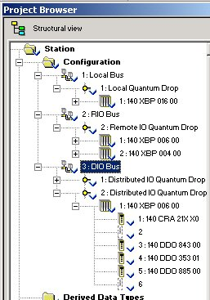
Remote I/O - Distributed I/O
Remote I/O (RIO)
  Decentralized input/output architecture solution
  Based on the input/output decentralization network technology S908
  Up to 31 decentralized stations
Distributed I/O (DIO)
  Distributed input/output solution
  Based on Modbus Plus technology
  32 subscribers may be configured over 500m

Slide 32
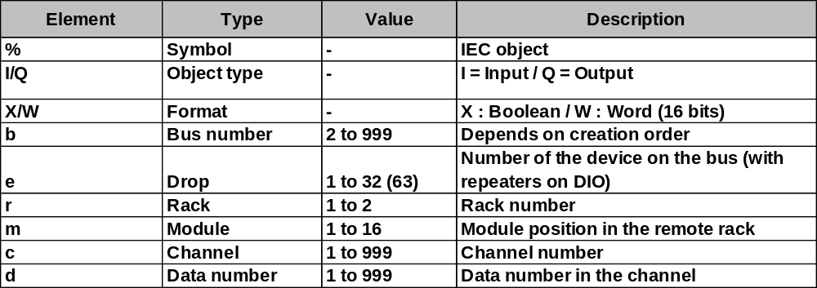
Topological Addressing
Physical addressing of input / output

